Slide 1

Cyber Security Data Analysis
GRAPHS AND PLOTS OF DATA ANALYSIS

Slide 2
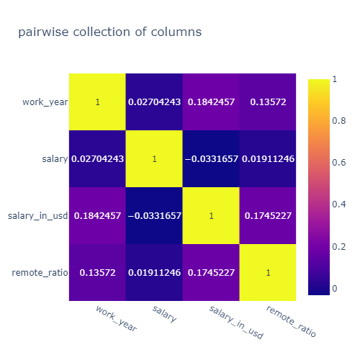
Pairwise correlation of Columns
There is a low correlation between all of the columns

Slide 3
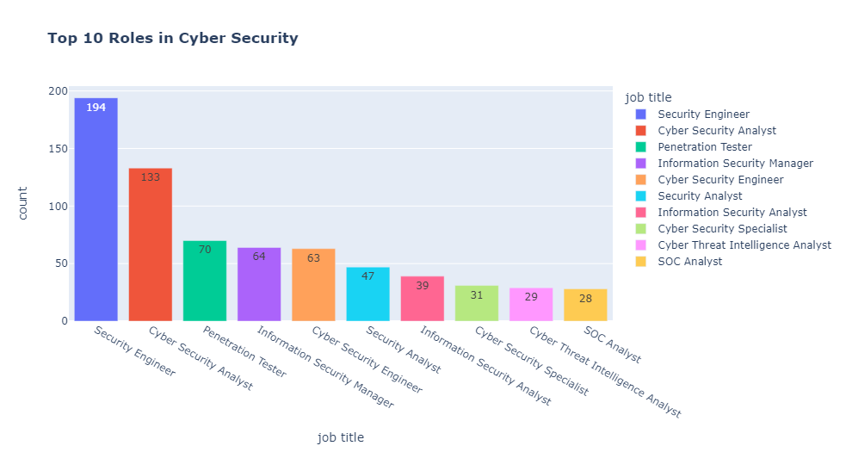
Top 10 Roles in Cyber Security

Slide 4
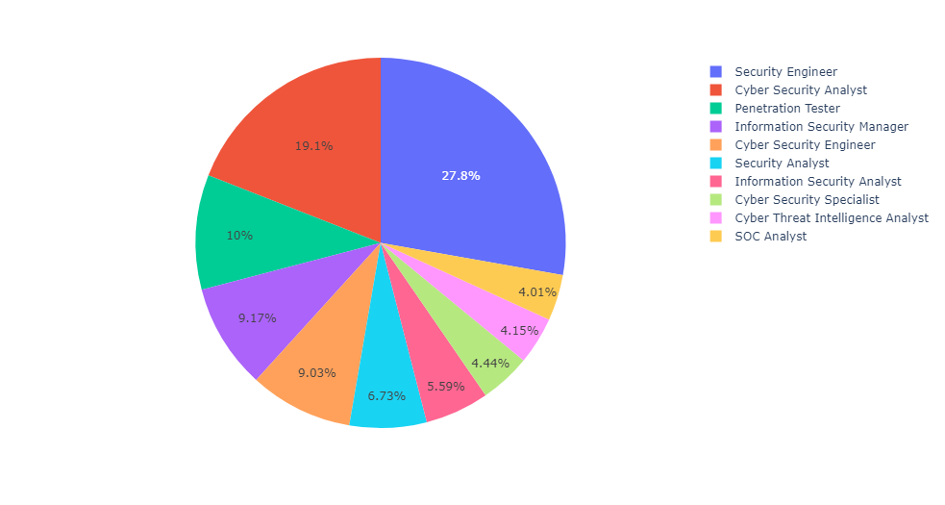
Top 10 Roles in Cyber Security
PPPP

Slide 5
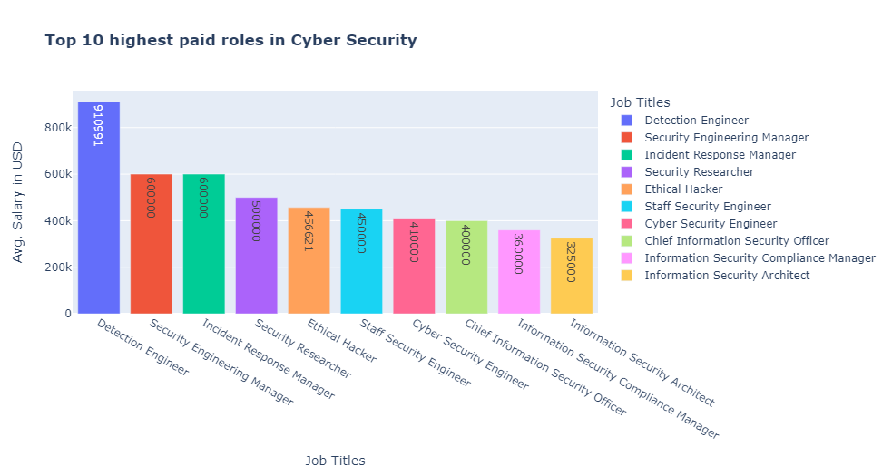
Top 10 highest paid roles in Cyber Security

Slide 6
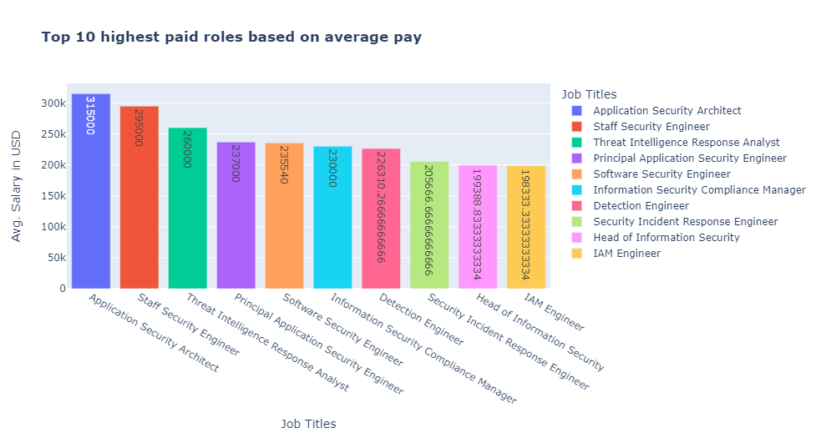
Top 10 highest paid roles based on average pay

Slide 7
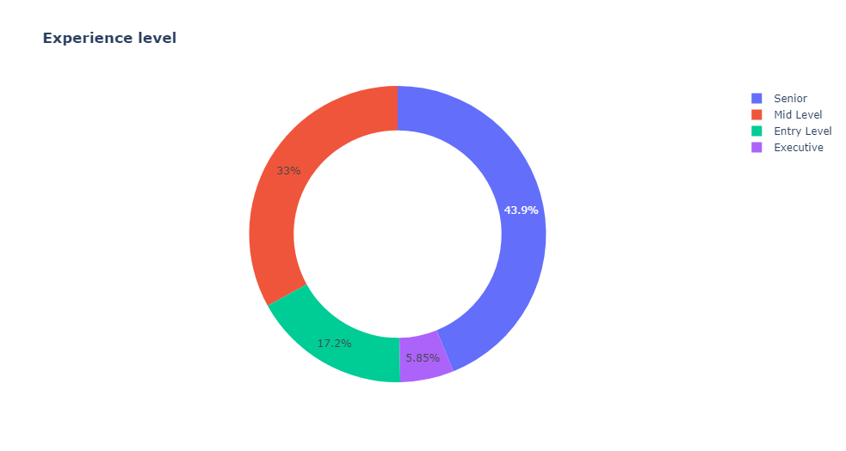
Experience level

Slide 8
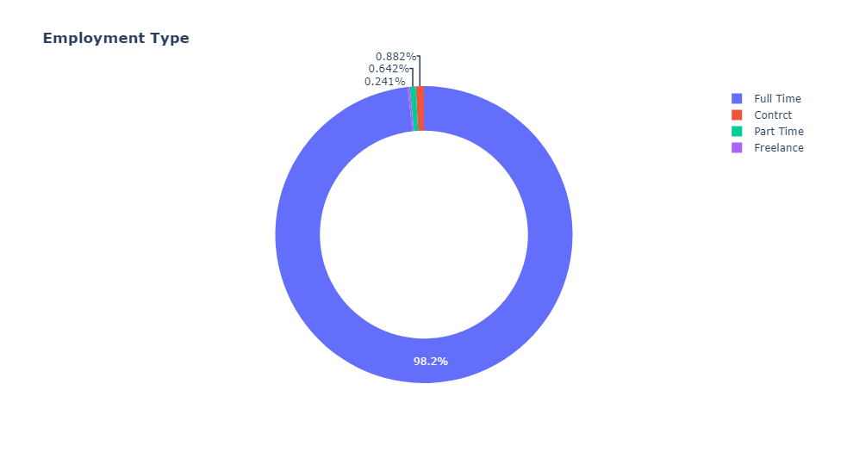
Employment Type

Slide 9
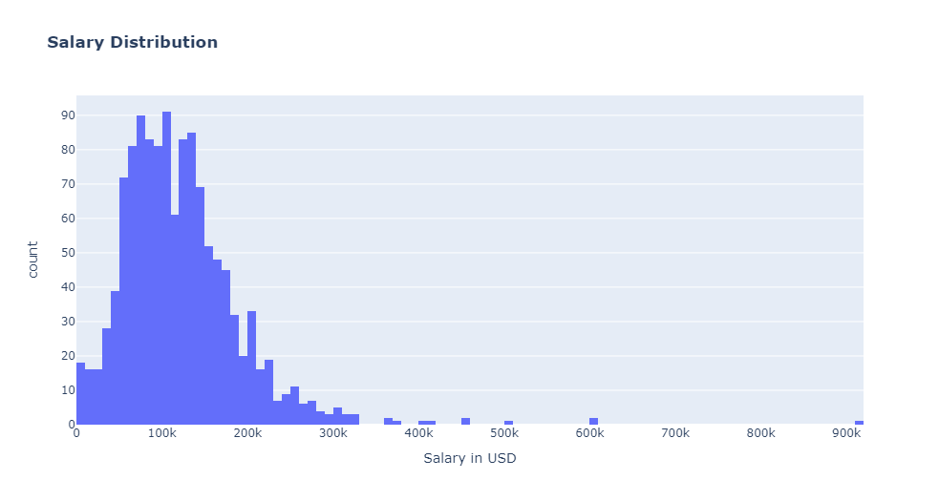
Salary Distribution

Slide 10
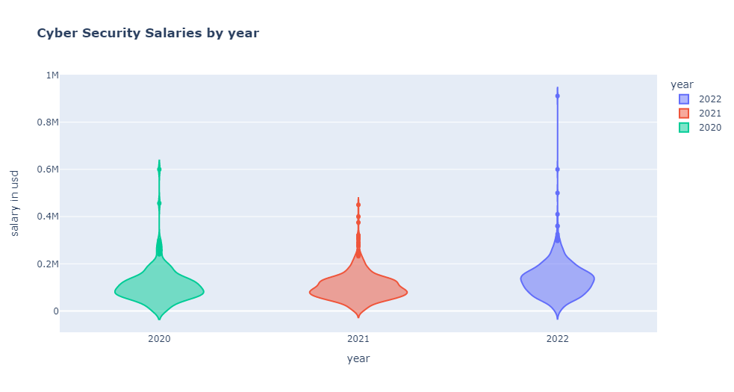

Slide 11
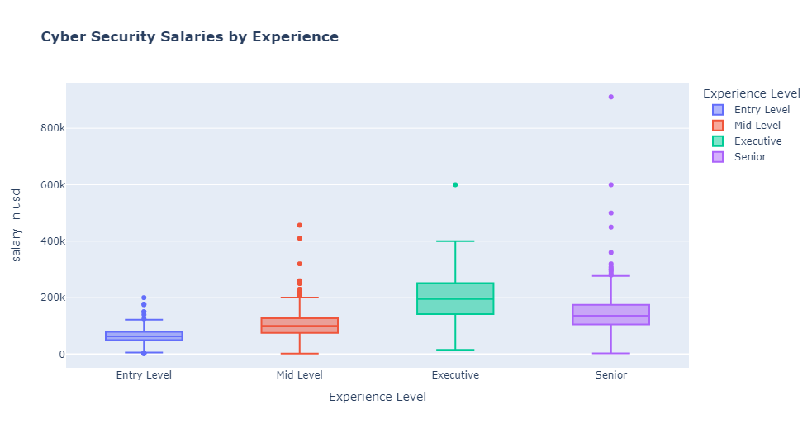

Slide 12
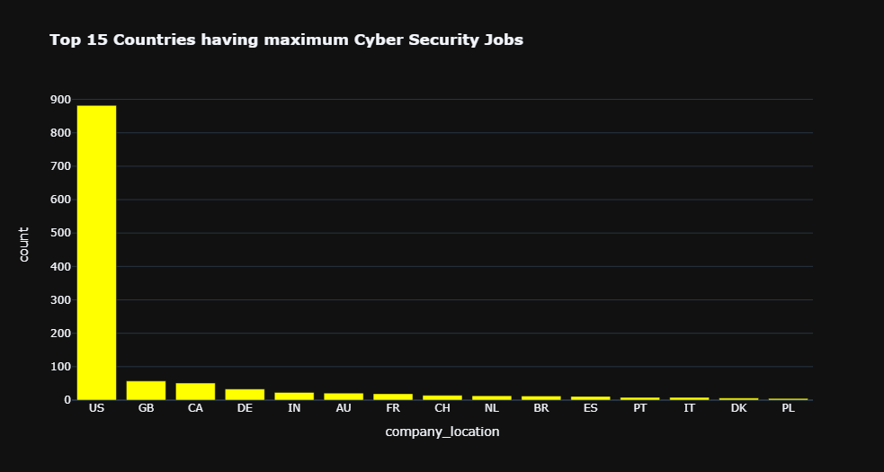

Slide 13
